Slide 1
The Panorammer
CMPT 470 Final Project – Neal Hamacher and Conlan Myers

Slide 2
Project Outline
Build on the panorama lab to create a general-purpose panorama generator
Inspired by OpenCV Stitcher API
Desired features:
Works with colour images
Works with any number of images and any layout
Automatically generate a layout
Automatically crop the image
Blend the portions of the image where they overlap

Slide 3
Feature 1: Colour Panoramas
Modification to lab assignment 3 code to allow to blend images with a 3rd dimension (for colour space)
Works with RGB images only
Initially did keypoint matching on all 3 colours, later revised to do colour matching on grayscale images to improve speed of execution
Fairly straightforward to implement initially, led to some headache as the project progressed
Required making two versions of many functions, one for 2D arrays, one for 3D arrays

Slide 4

Feature 2: Build panorama out multiple images
First version takes in a list of images and a paired list of locations
Initializes a canvas
Requirements:
Images are the same size (approximately
Images are the same colour scheme (RGB

Slide 5
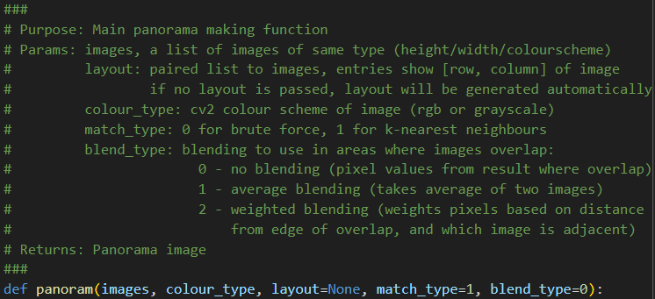
The Panorammer API
All functionality is wrapped up in a “tidy” API called with the panoram function

Slide 6
Two content layout with table
First bullet point here
Second bullet point here
Third bullet point here
Class | Group 1 | Group 2
Class 1 | 82 | 95
Class 2 | 76 | 88
Class 3 | 84 | 90

Slide 7
Title and content layout with SmartArt
Step 1 Title
Task description
Step 2 Title
Task description
Step 3 Title
Task description

Slide 8
Add a Slide Title - 1

Slide 9
Add a Slide Title - 2

Slide 10
Add a Slide Title - 3

Slide 12
Add a Slide Title - 4

Slide 13
Add a Slide Title - 5

